Slide 1
Kinematic viscosity estimates in reversed-field pinch fusion plasmas
Meeting 29/09/2022
Nicholas Vivenzi

Slide 2
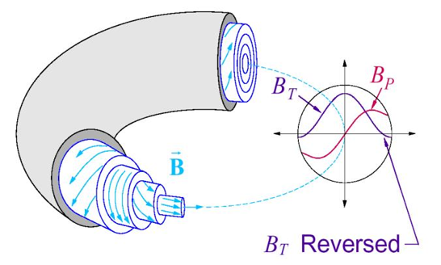
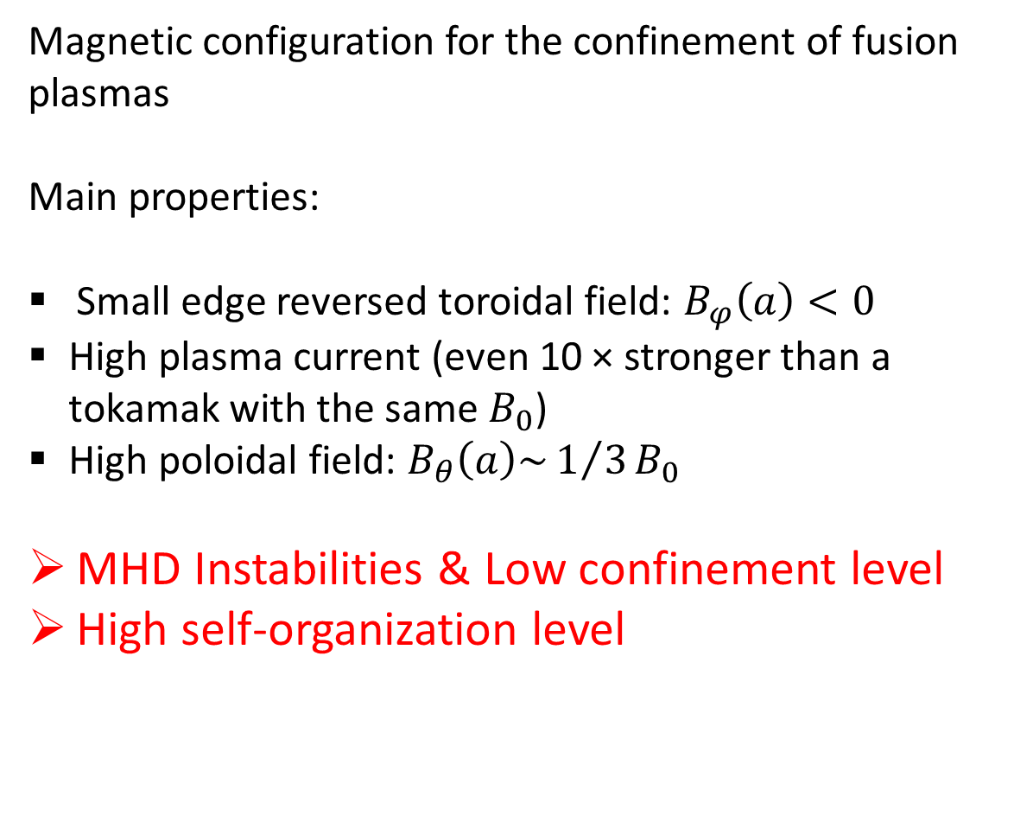
Reversed-Field Pinch (RFP) configuration
Magnetic configuration for the confinement of fusion plasmas
Main properties:
Small edge reversed toroidal field: $B_{φ}\left(a\right)<0$
High plasma current (even 10 × stronger than a tokamak with the same $B_{0}$)
High poloidal field: $B_{θ}\left(a\right){\sim 1/3B}_{0}$
MHD Instabilities & Low confinement level
High self-organization level

Slide 3
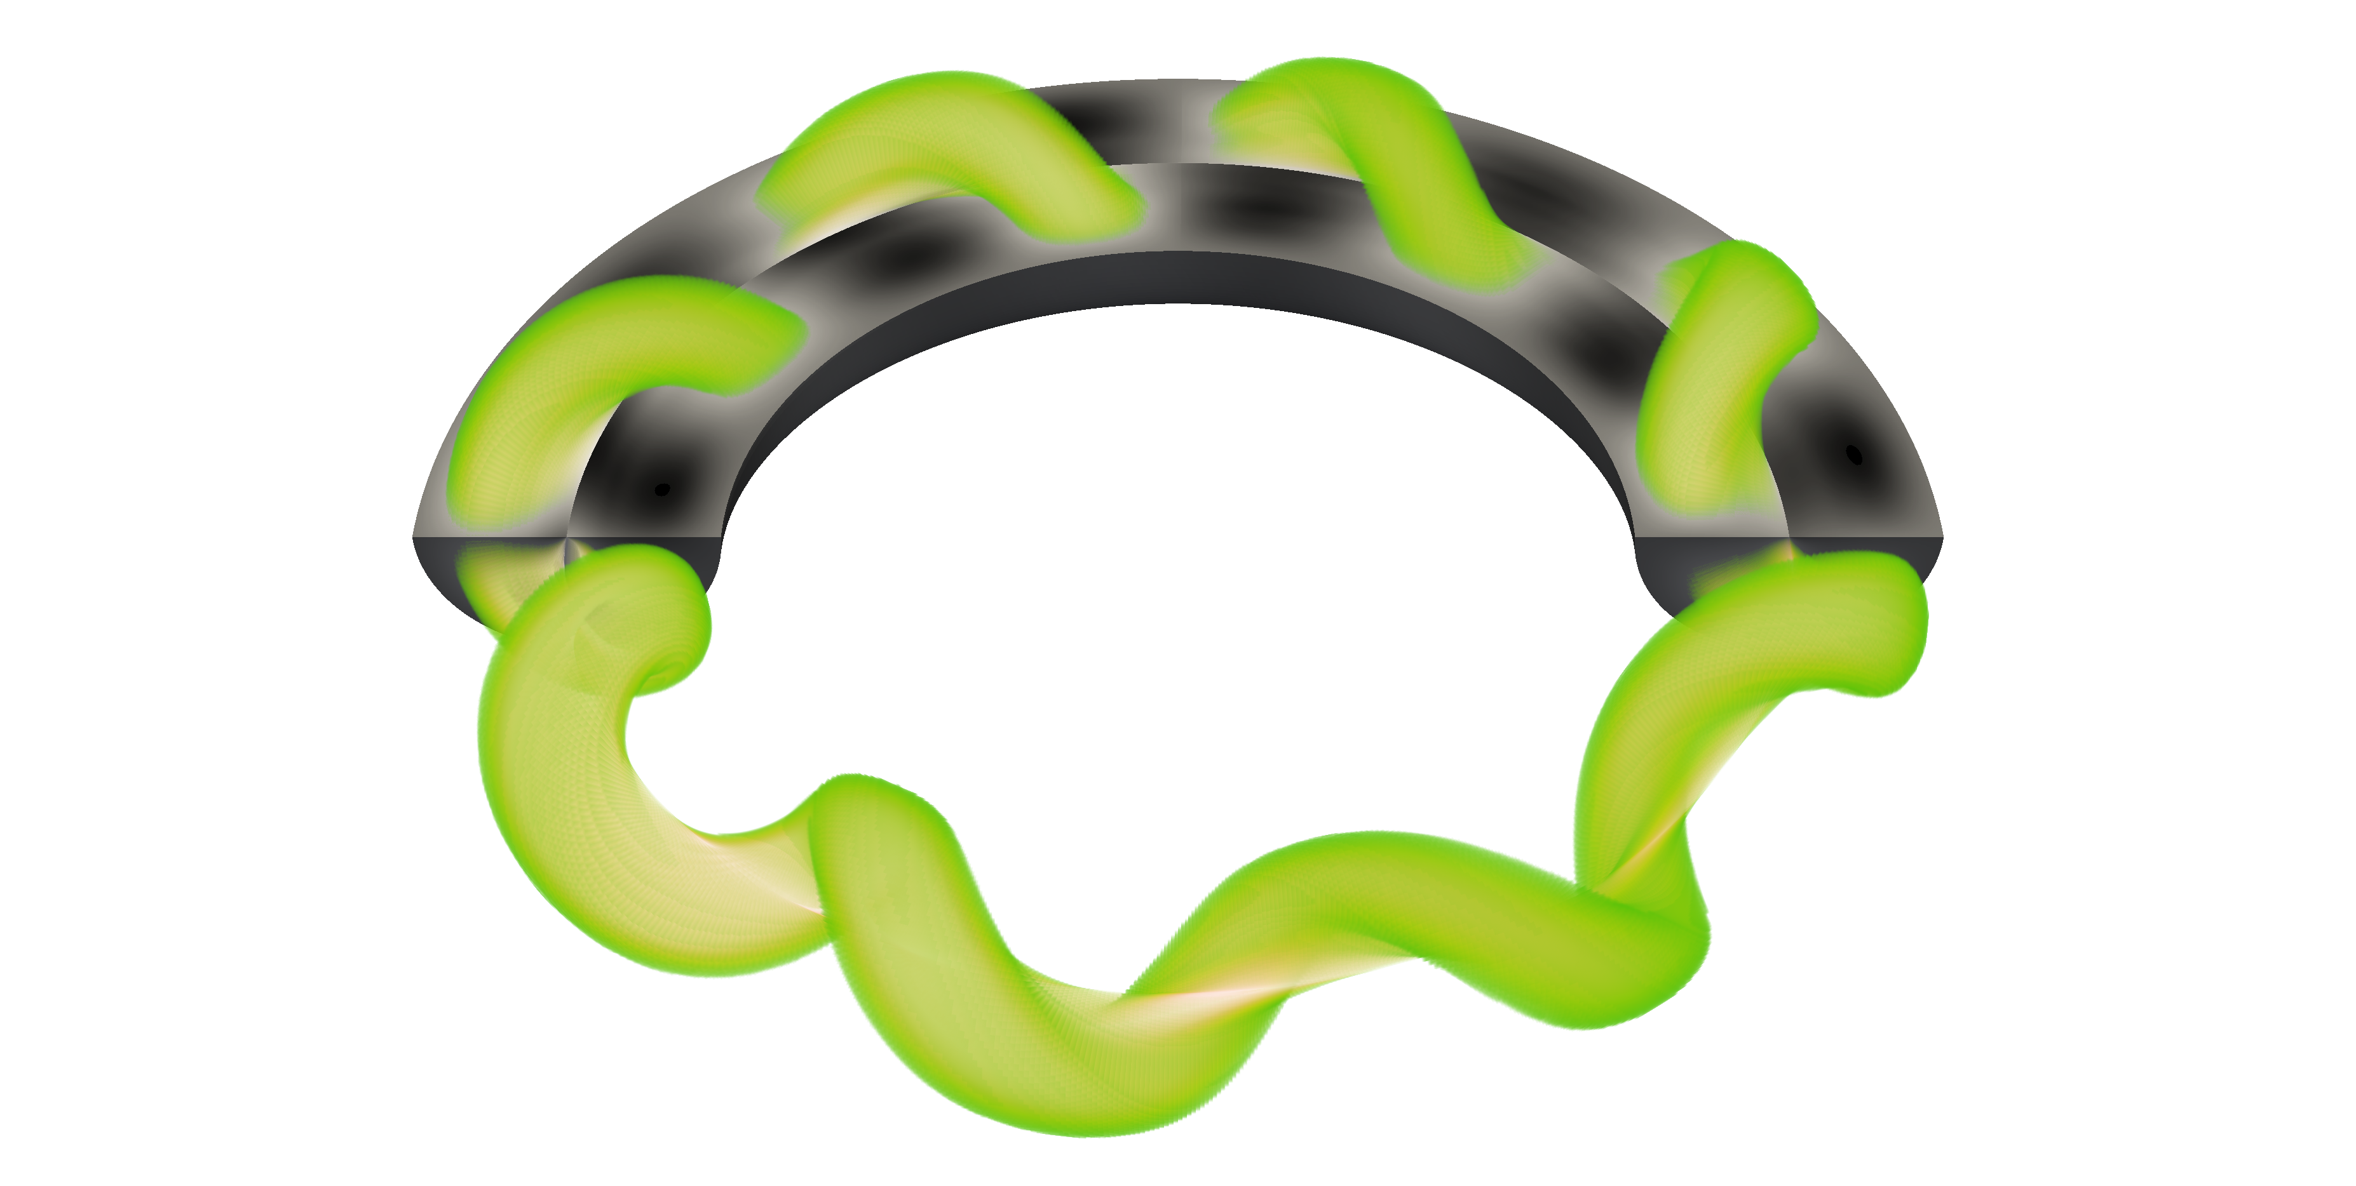
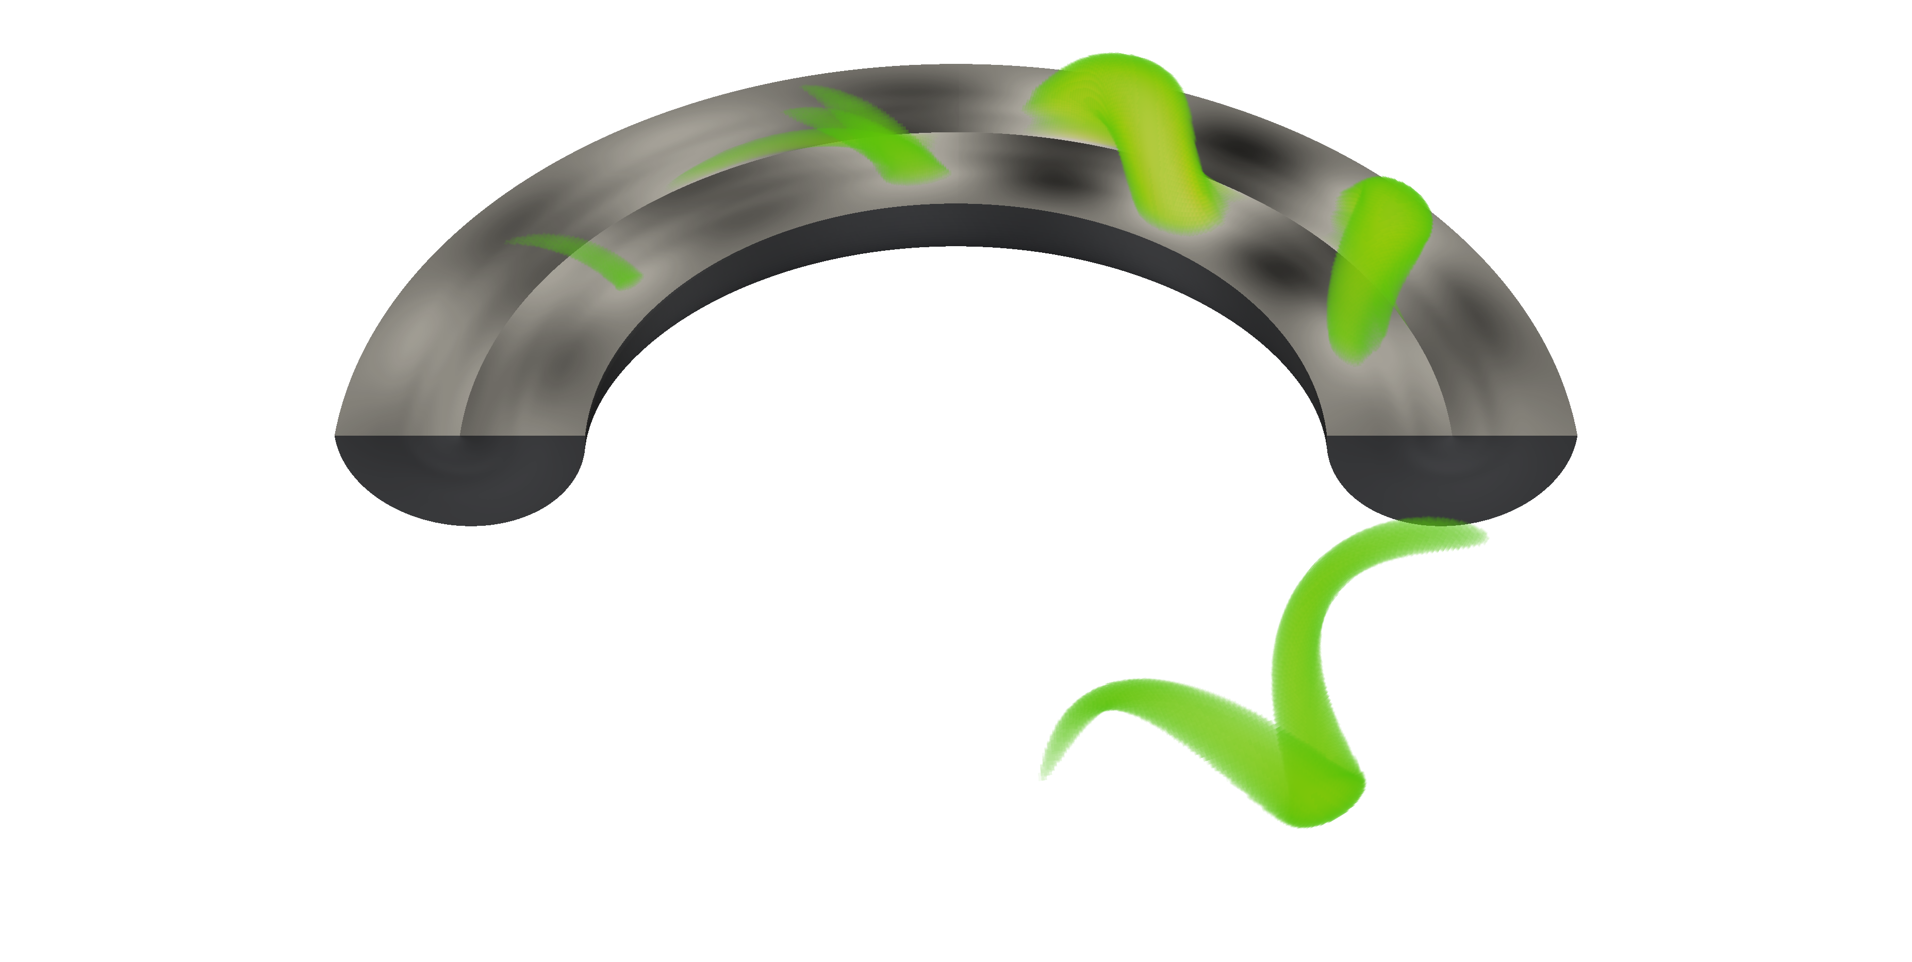
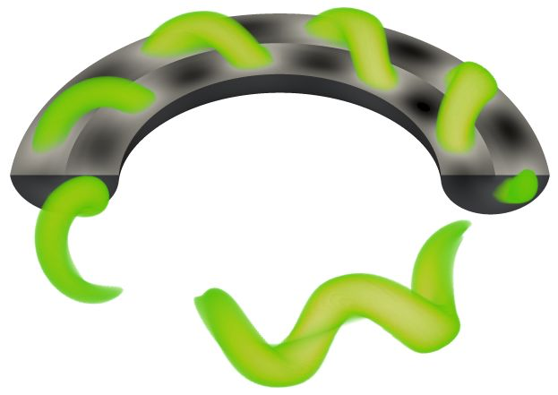
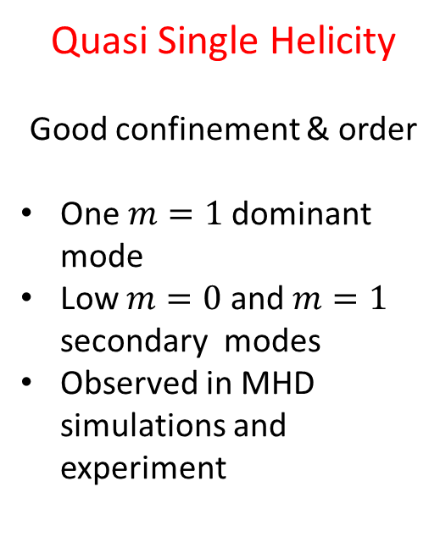
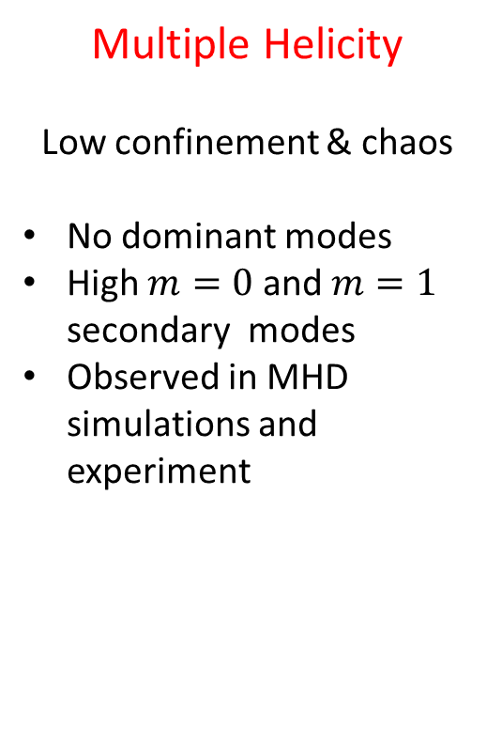
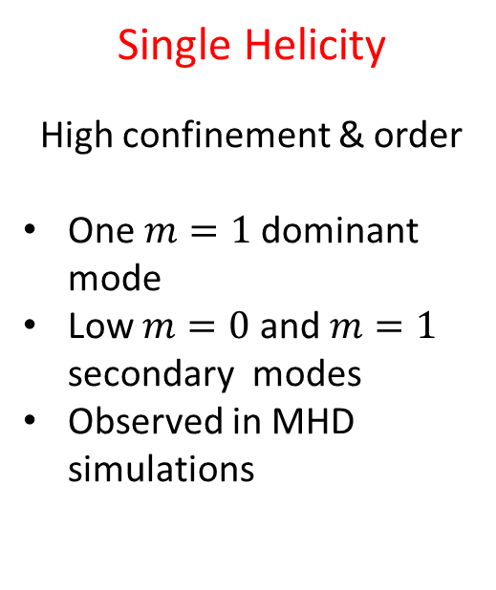
Reversed-Field Pinch helical regimes
Single Helicity
High confinement & order
One $m=1$dominant mode
Low $m=0$ and $m=1$ secondary modes
Observed in MHD simulations
Multiple Helicity
Low confinement & chaos
No dominant modes
High $m=0$ and $m=1$ secondary modes
Observed in MHD simulations and experiment
Quasi Single Helicity
Good confinement & order
One $m=1$dominant mode
Low $m=0$ and $m=1$ secondary modes
Observed in MHD simulations and experiment

Slide 4
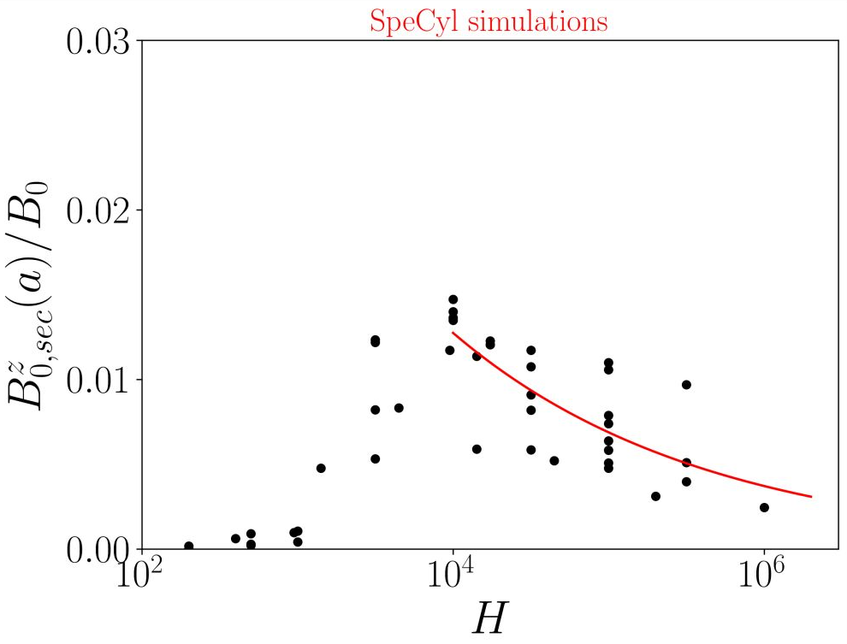
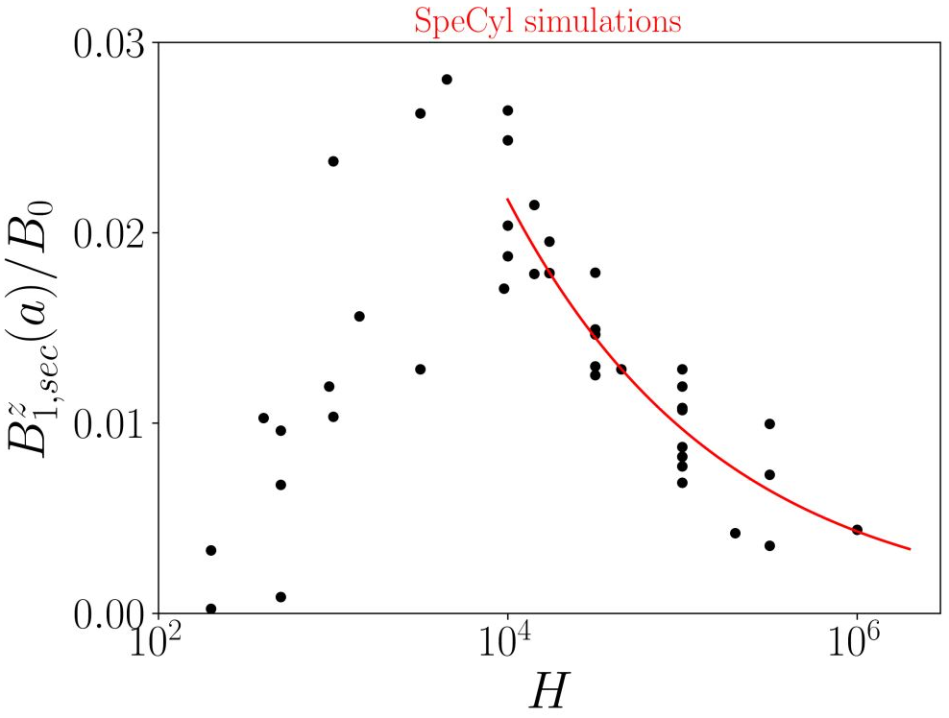
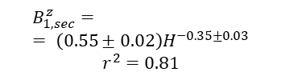

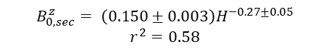
Helical regimes are ruled by the Hartmann [MHD simulations]
The Hartamann is a fluid dimensionless number: $H=1/{\sqrt{ην}}$, η: dimensionless resitivity ν: dimensionless viscosity
SH: $H<2500$ MH: $2500<H<7∙{10}^{4}$ QSH: $H>7 ∙{10}^{4}$
$$B_{0,sec}^{z}= \left(0.150±0.003\right)H^{−0.27±0.05}$$
$$r^{2}=0.58$$
$$B_{1,sec}^{z}== \left(0.55±0.02\right)H^{−0.35±0.03}$$
$$r^{2}=0.81$$
To extend this picture to exp. data we need to evaluate resistivity η (Spitzer) and viscosity ν (?)

Slide 5
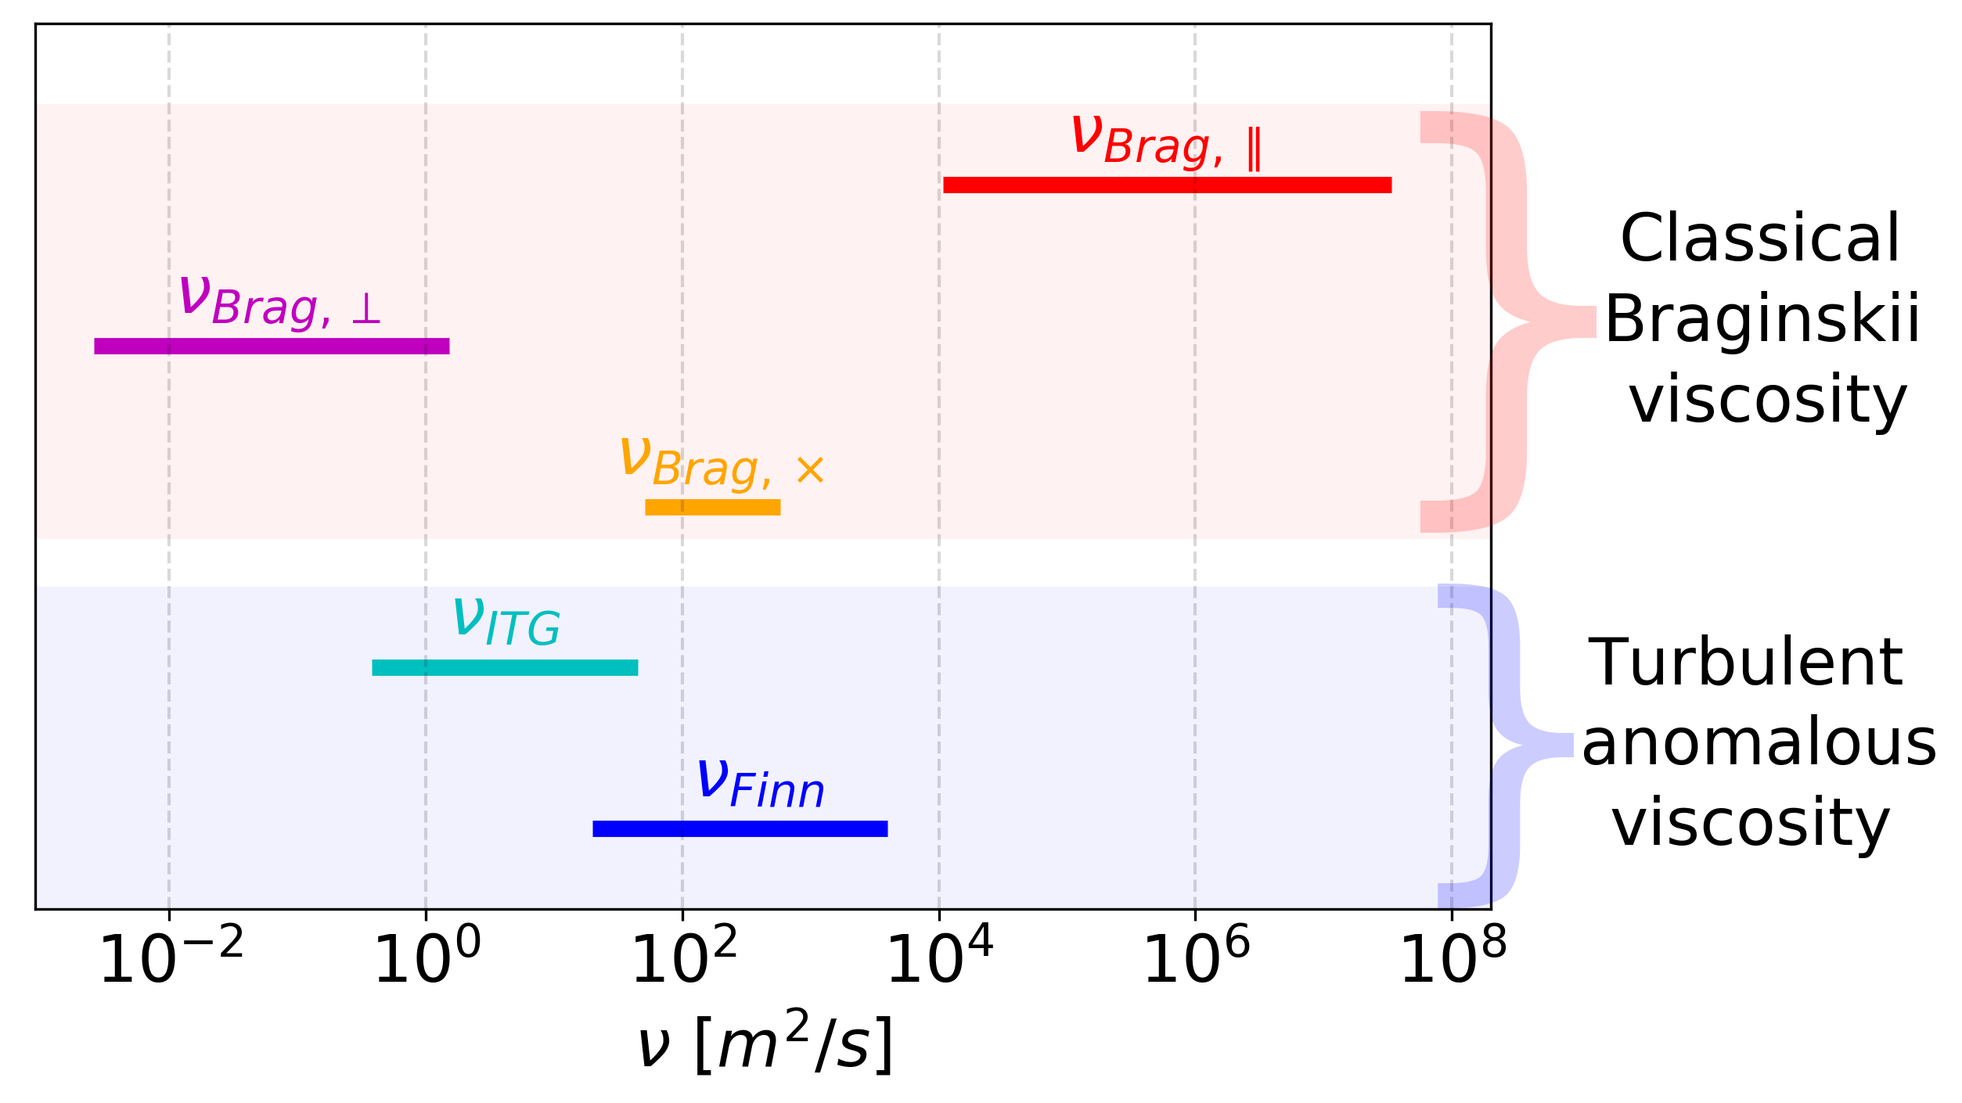
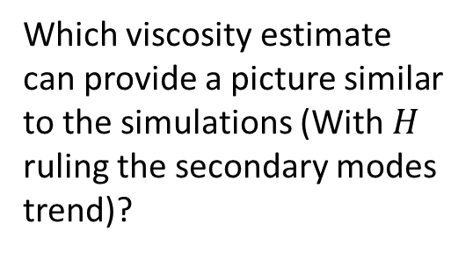
Viscosity estimates in RFP plasmas
Transport theory provides expression for viscosity as function of plasma parameter: $ν = ν (n, T, B, Z_{eff},γ)$
Classical Braginskii viscosity: momentum transport based on Coulomb collisions
ITG viscosity: based on ITG (ion temp. gradient) velocity fluctuations damping
Finn: magnetic diffusivity in a stochastic magnetic field
Evaluation on RFX-mod database
Which viscosity estimate can provide a picture similar to the simulations (With $H$ ruling the secondary modes trend)?

Slide 6
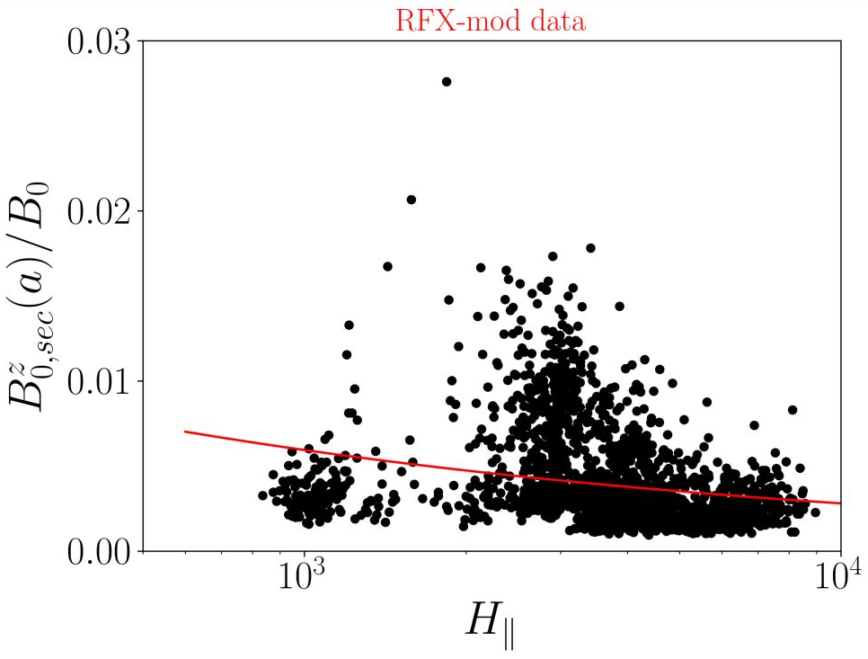
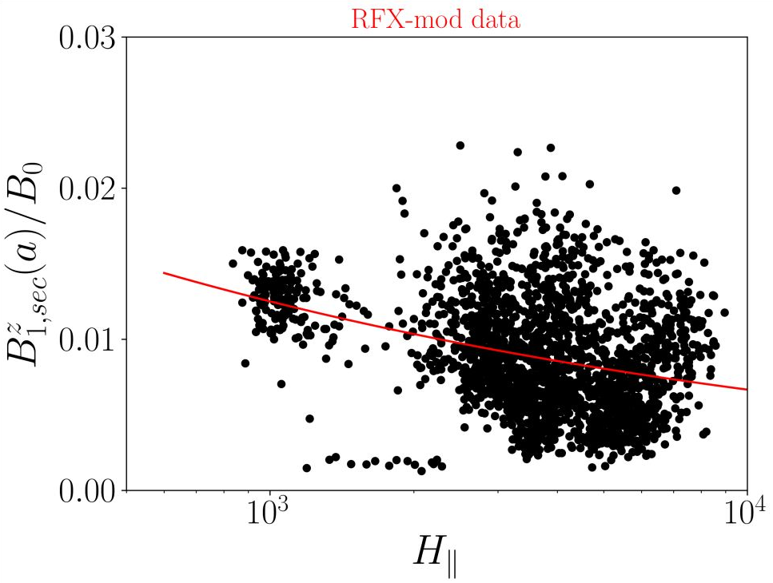
Power-law (OLS fit) [tentative]: $H_{∥}$
$$B_{0,sec}^{z} \sim H_{∥}^{−0.33±0.03} r^{2}=0.13$$
$$B_{1,sec}^{z} \sim H_{∥}^{−0.27±0.02} r^{2}=0.09$$

Slide 7
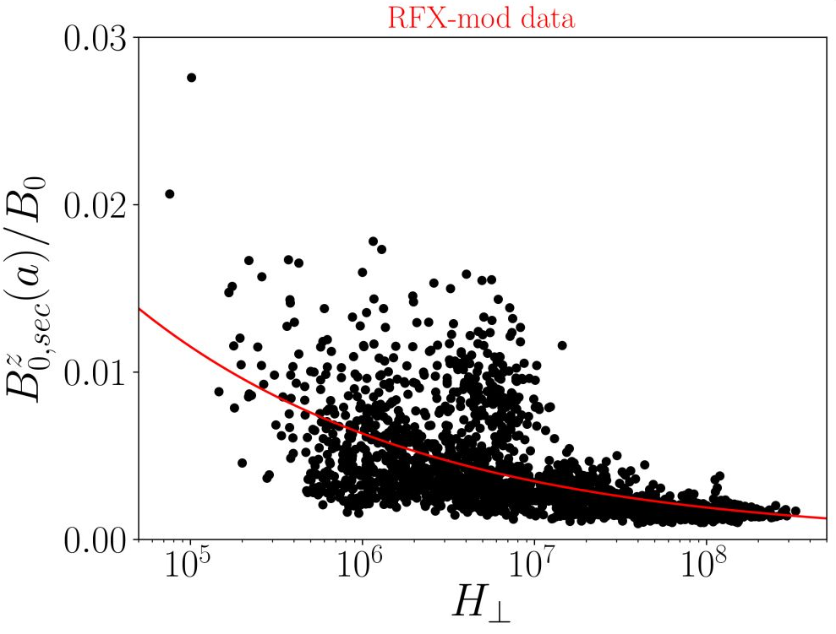
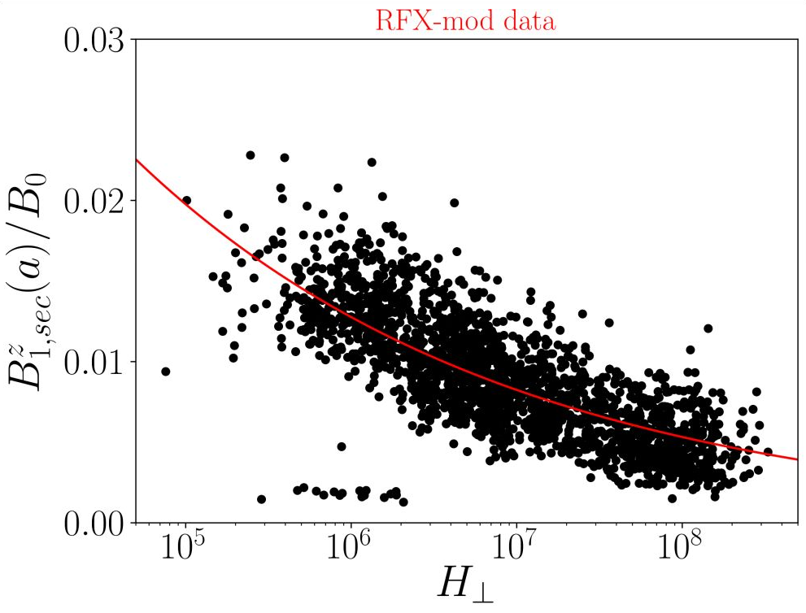
Power-law (OLS fit) [tentative]: $H_{⊥}$
$$B_{0,sec}^{z} ∝ H_{⊥}^{−0.260±0.009} r^{2}=0.50$$
$$B_{1,sec}^{z} ∝ H_{⊥}^{−0.190±0.004} r^{2}=0.53$$

Slide 8
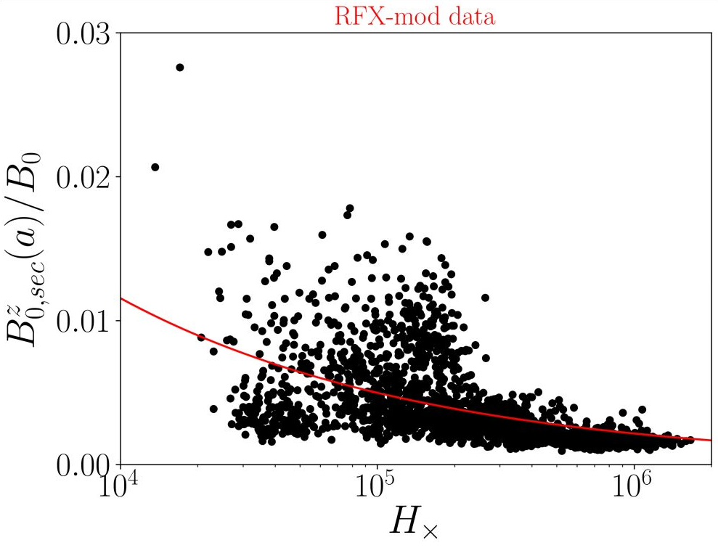
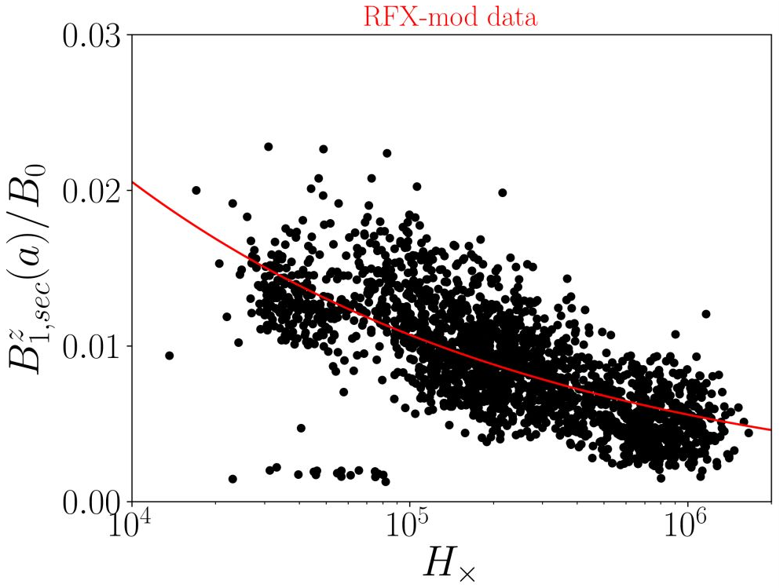
Power-law (OLS fit) [OLS]: $H_{×}$
$$B_{0,sec}^{z} ∝ H_{×}^{−0.37±0.01} r^{2}=0.46$$
$$B_{1,sec}^{z} ∝ H_{×}^{−0.283±0.006} r^{2}=0.47$$

Slide 9
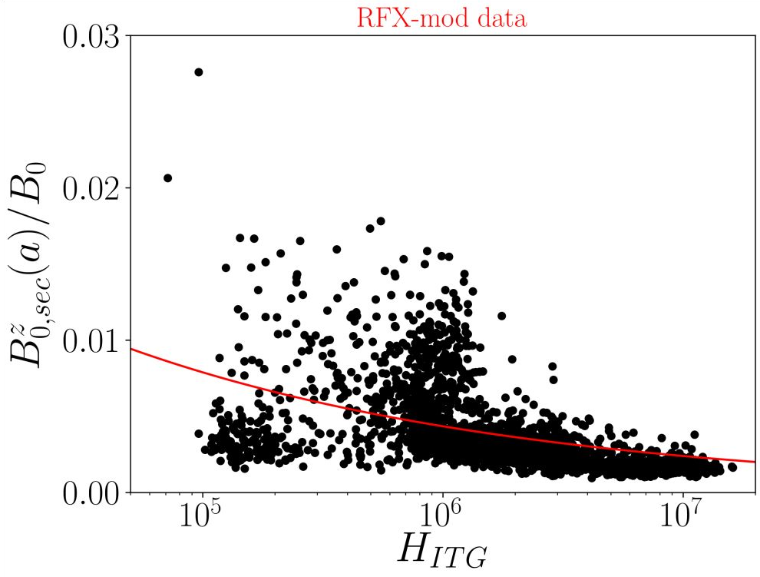
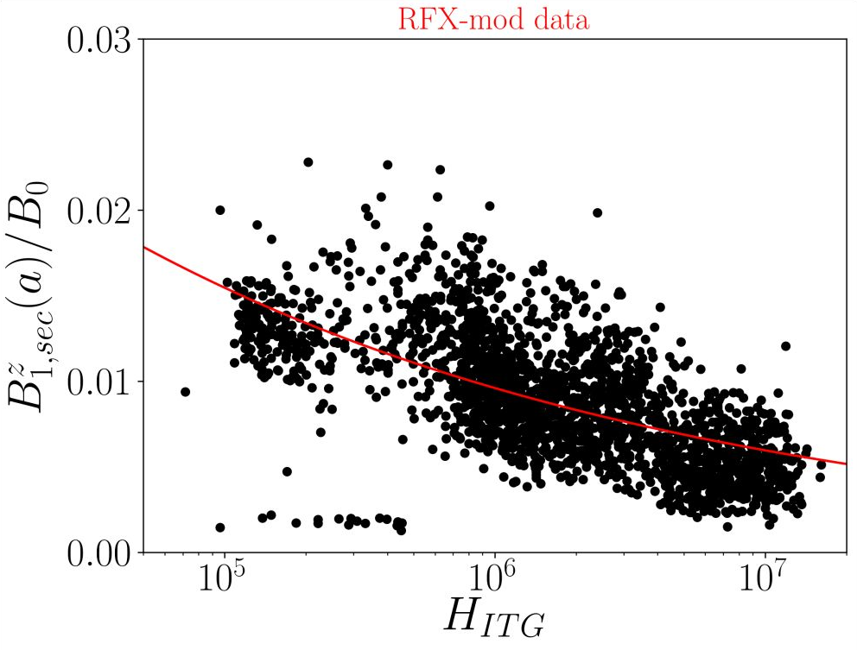
Power-law (OLS fit) [OLS]: $H_{ITG}$
$$B_{0,sec}^{z} ∝ H_{ITG}^{−0.26±0.01} r^{2}=0.42$$
$$B_{1,sec}^{z} ∝ H_{ITG}^{−0.207±0.006} r^{2}=0.39$$

Slide 10
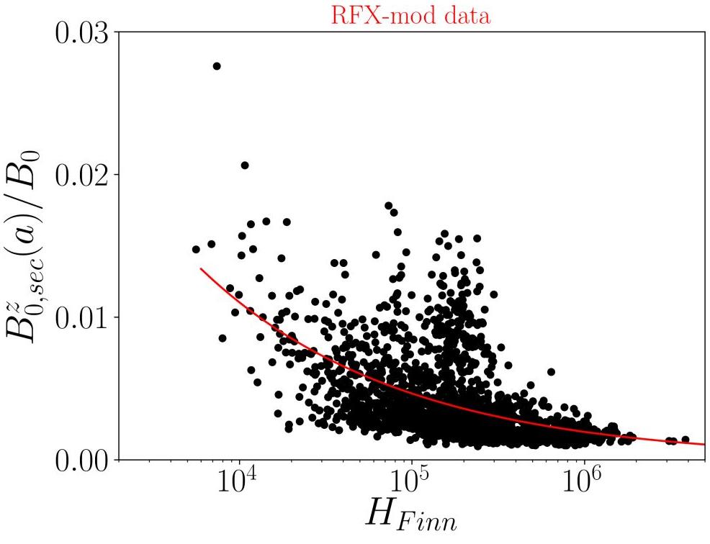
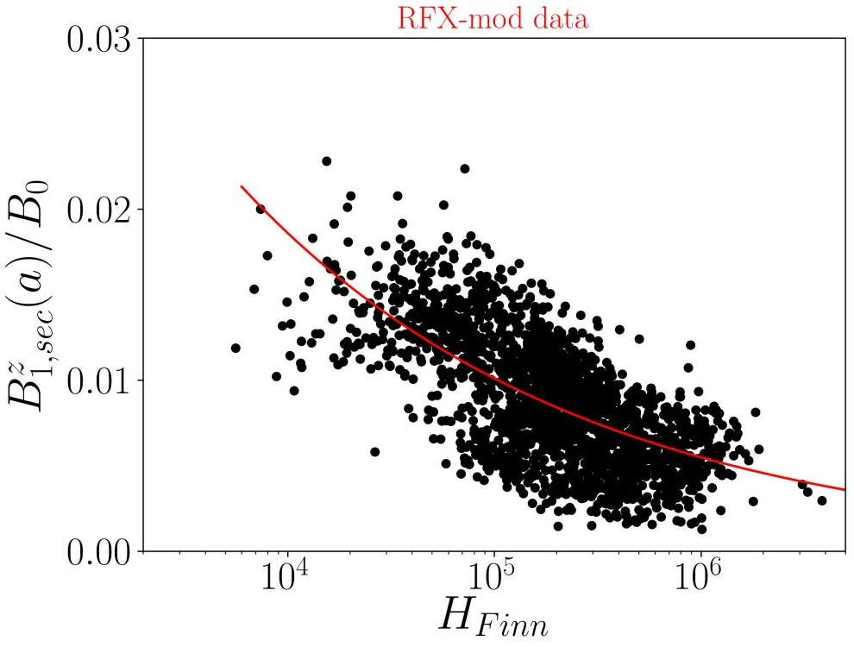
Power-law (OLS fit) [OLS]: $H_{Finn}$
$$B_{0,sec}^{z} ∝ H_{Finn}^{−0.38±0.01} r^{2}=0.37$$
$$B_{0,sec}^{z} ∝ H_{Finn}^{−0.265±0.006} r^{2}=0.39$$

